Slide 1
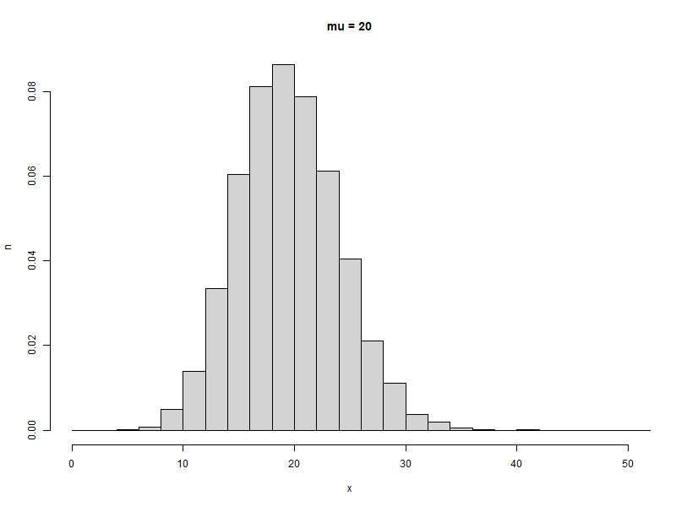
Justifying sample size with a Poisson-based simulation
Przemek Dolowy
HARUG 2021.11.24

Slide 2
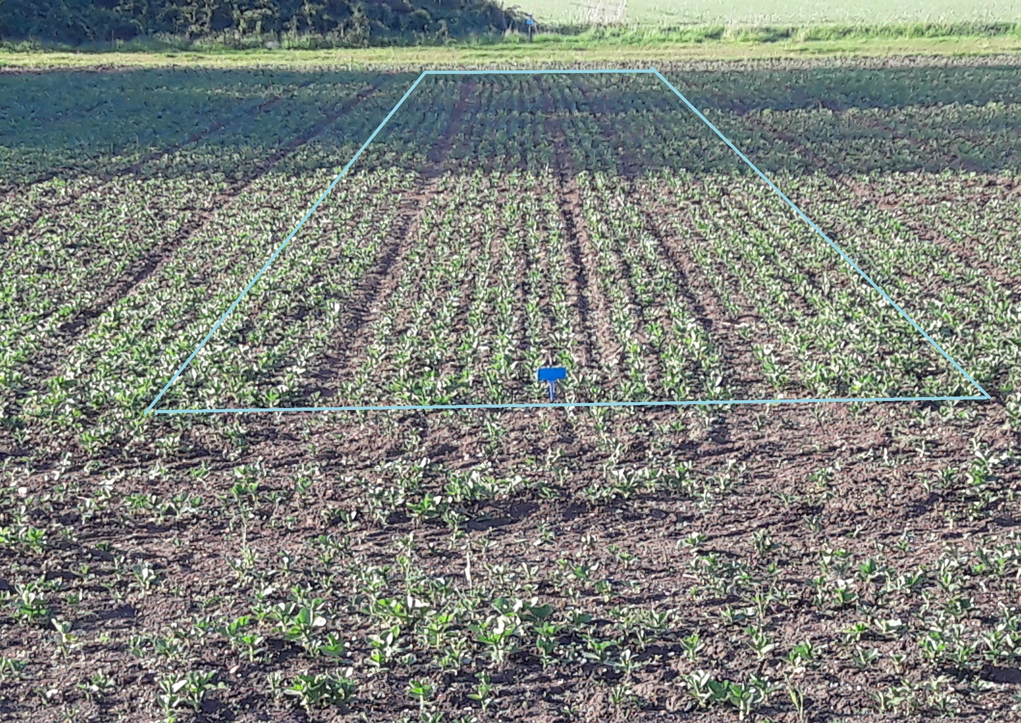
Research task
Find the mean number of plants per unit length of row
plant stand
germination ratio
yield
Similar problems
population census and density
events that happen in time

Slide 3
Sampling
0.5

Slide 4
Sampling
0.5

Slide 5
Sampling
0.5
x = 3

Slide 6
Sampling
0.5
x = 3

Slide 7
Sampling
0.5
x = 3
x = 3
x = 4
x = 2

Slide 8
Sampling
0.5
x = 3
sum(x) = 12
N = 4
L = 0.5
Estimation of mean
from survey
12 / (4 * 0.5) =
= 6
x = 3
x = 4
x = 2

Slide 9
Poisson distribution – a short recap
Data from counting
along sections of length L
on plots of area L
in time of length L
follow Poisson distribution
F(k, lambda)
where k = 0, 1, 2...
lambda is the mean (expected number of occurrences)
!! NB. I will be using different variable names in my scripts!!!
k >>> x
lambda >>> mt

Slide 10
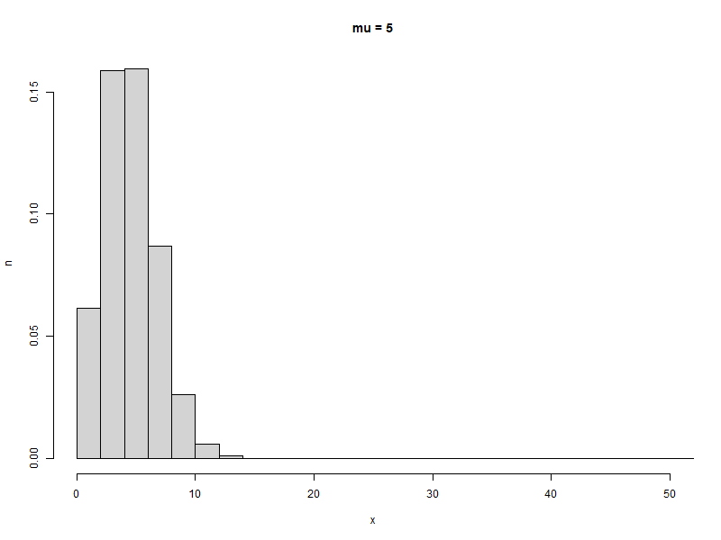

Slide 11
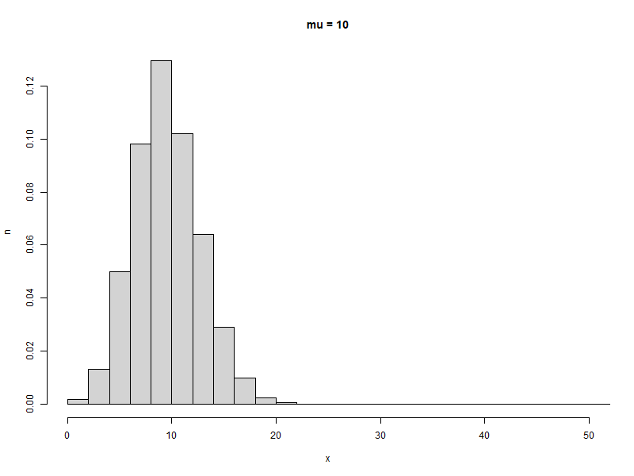

Slide 13
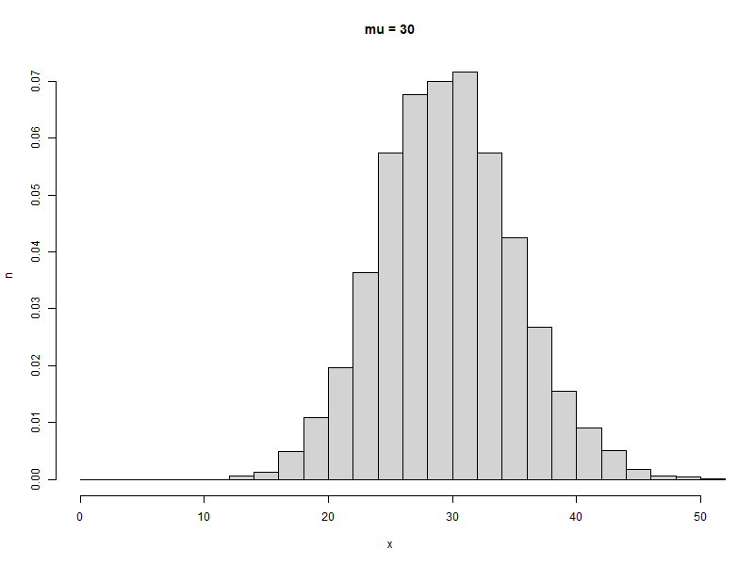

Slide 14
Problem
How to find the optimal length of transect?
Alternatively:
- on a field with a given plant stand (expressed by mu),
- with a given transect length L,
- with a given number of transects N,
- with required accuracy of +/- d,
What is the p-value for the measurement?

Slide 15
Problem
How to find the optimal length of transect?
Alternatively:
- on a field with a given plant stand (expressed by mu),
- with a given transect length L,
- with a given number of transects N,
- with required accuracy of +/- d,
What is the p-value for the measurement?
not too long because of workload
not too short because of accuracy

Slide 16
Parameters and variables
from drill settings,
from a rough estimation...
L transect length
N number of observations (transects) in a sample
x number of plants on a transect
mu global mean – number of plants per unit length of row
mt expected number of plants per transect (mt <- mu * L)
m approximation of mt from survey
d required accuracy (+/- d*mu)
p.valueprobability that (mu - d*mu) < m < (mu + d*mu)

Slide 17
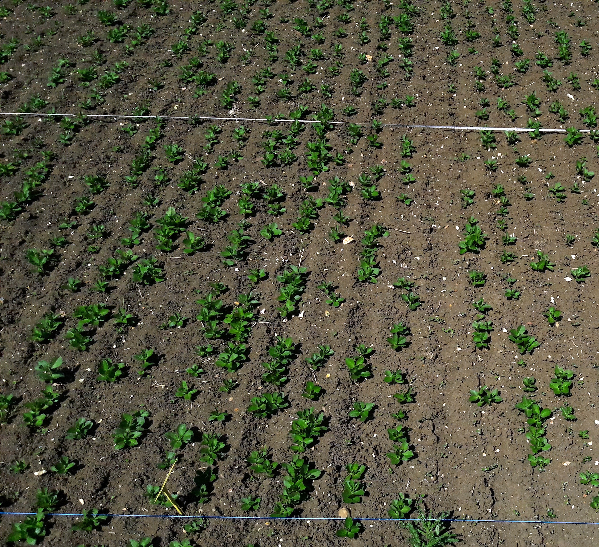
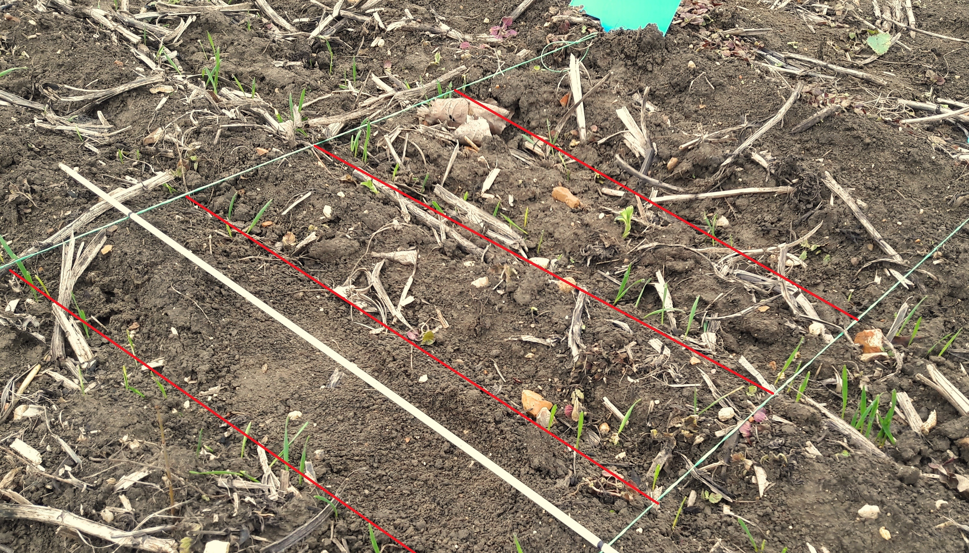
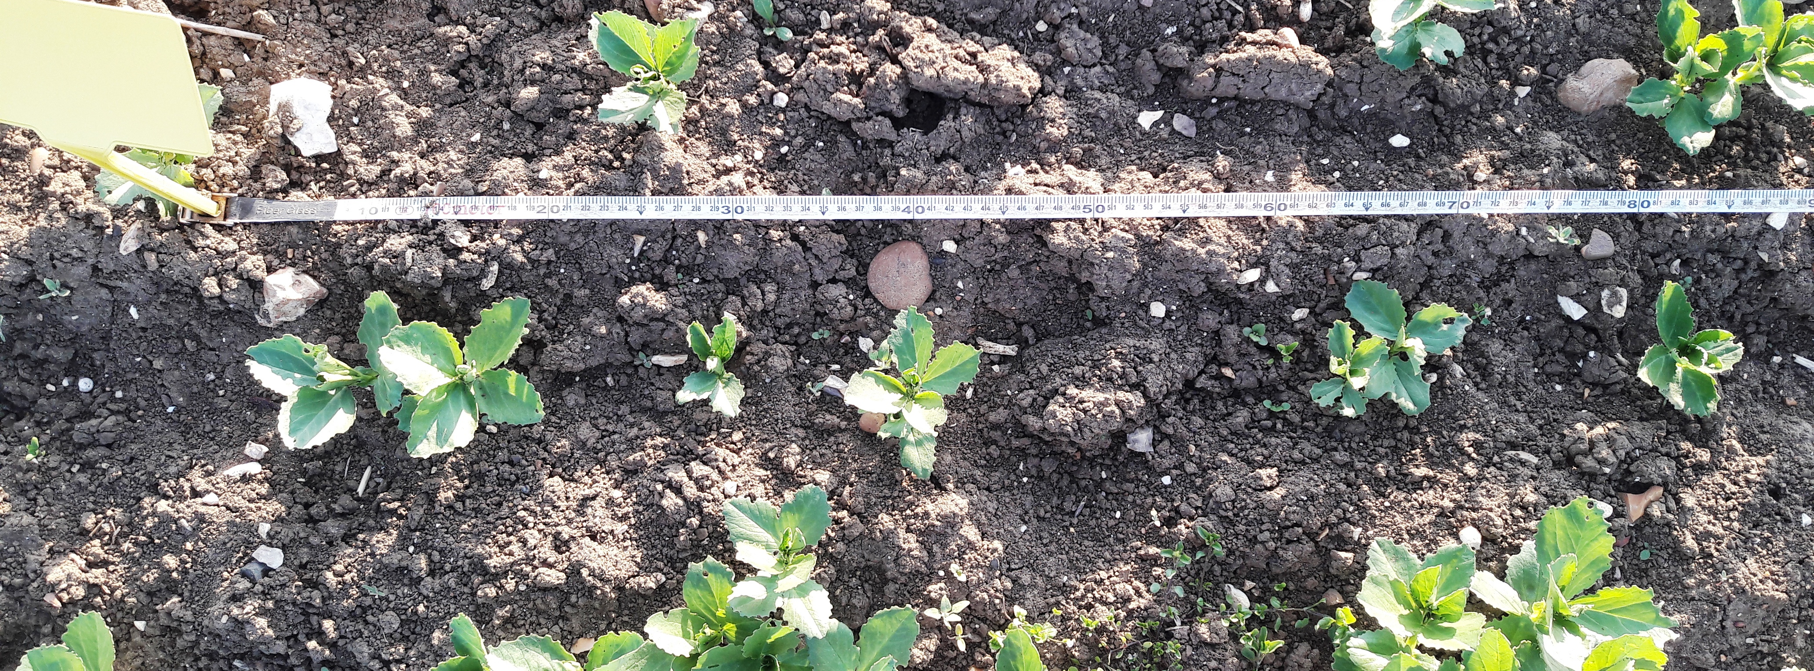
Script 1 is testing the Poissonian assumption on real-life data
Script 2 is looking into relationship between mu, L, N, d and p-value

