Slide 1
Linear Mixed Effects models
State of practice and background
with blocking examples
FIXED effects
HARUG!
2021-12-08
Ed Harris
RANDOM effects

Slide 2
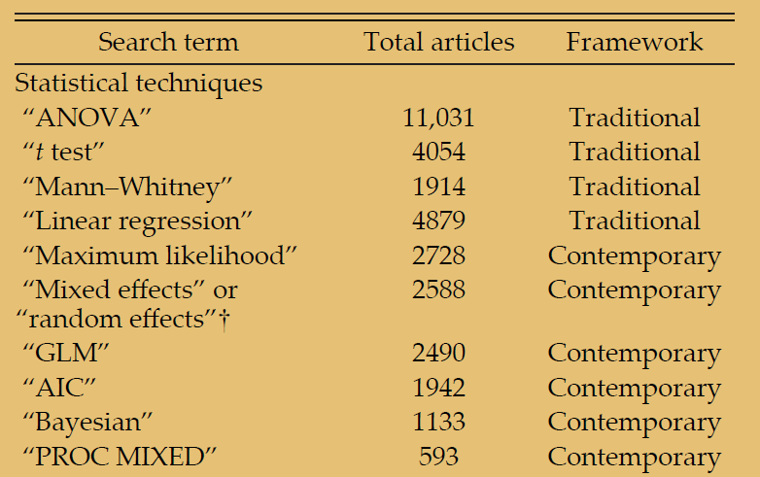
Stats techniques used in papers (since 1990)
Touchon & McCoy 2016

Slide 3
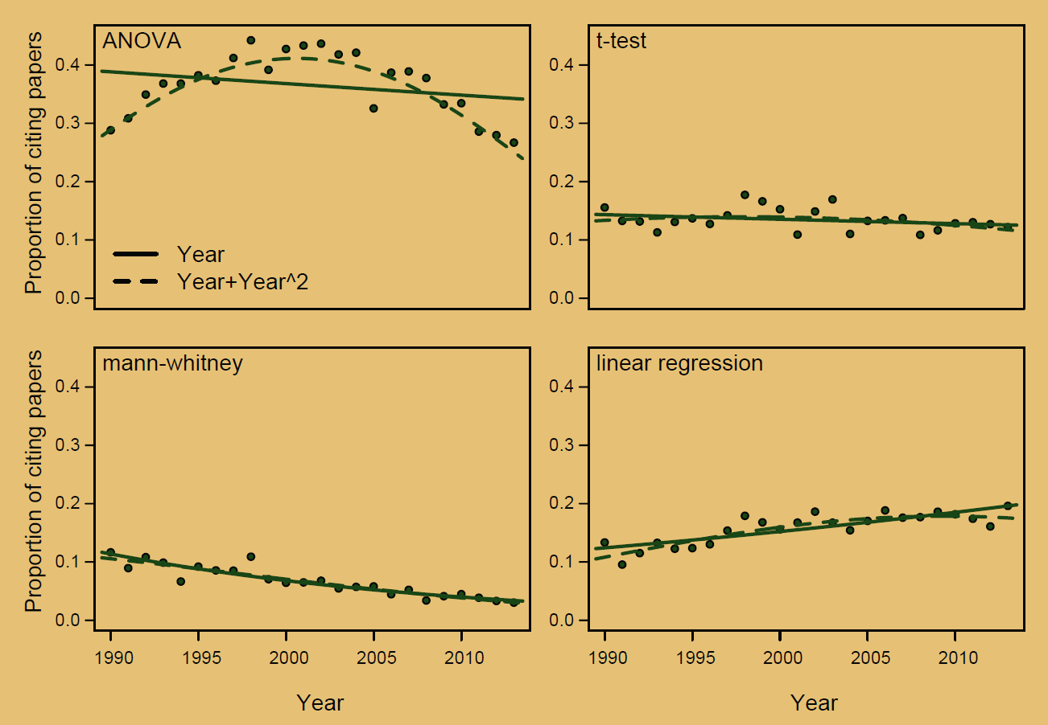
Stats techniques used in papers (since 1990)
'Traditional'
techniques
Touchon & McCoy 2016

Slide 4
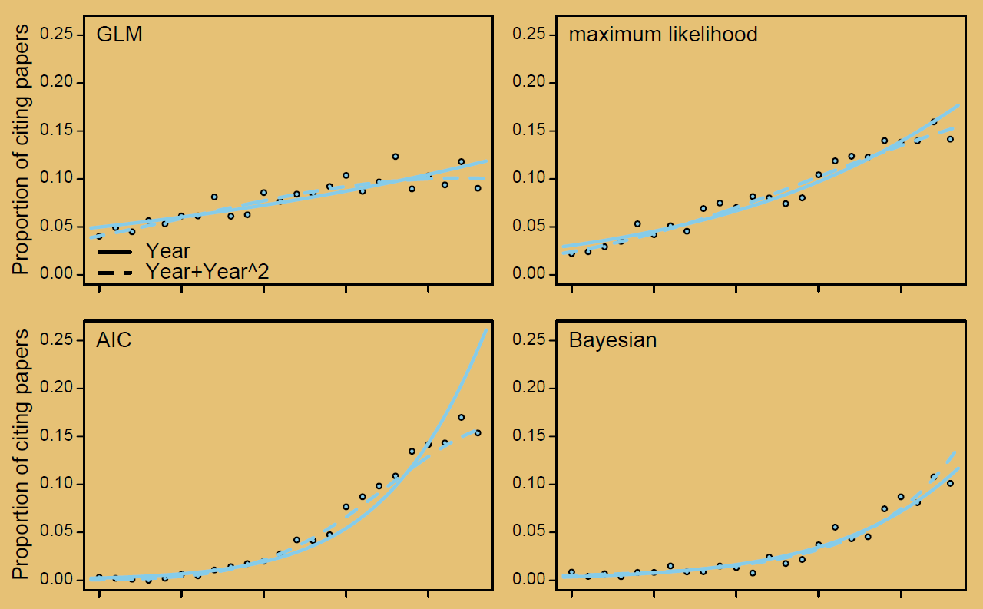
Stats techniques used in papers (since 1990)
'Modern'
techniques
Touchon & McCoy 2016

Slide 5
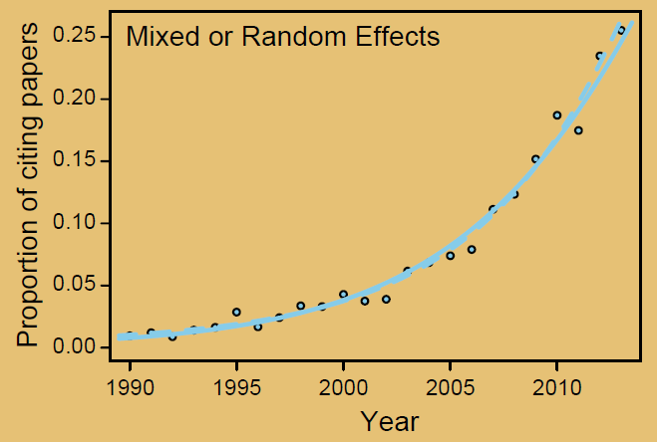
Stats techniques used in papers (since 1990)
'Modern'
techniques
Touchon & McCoy 2016

Slide 6
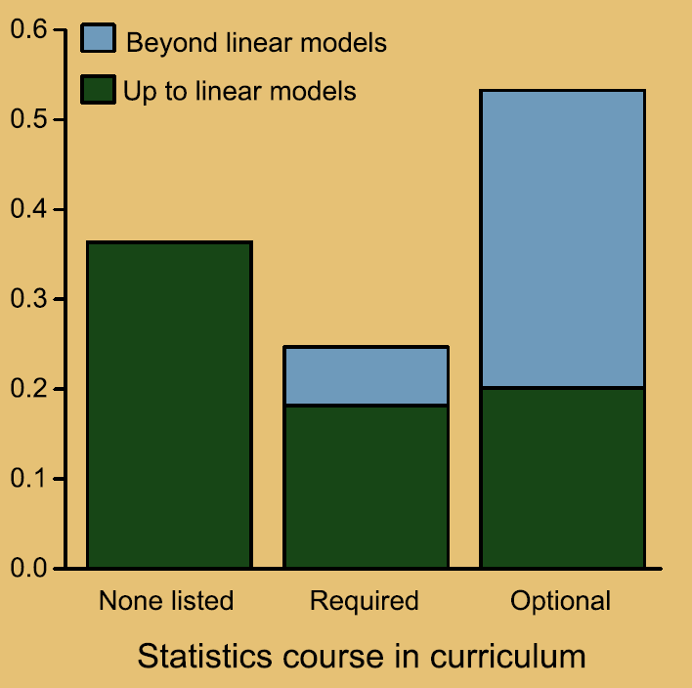
Training in research degrees
Touchon & McCoy 2016

Slide 7
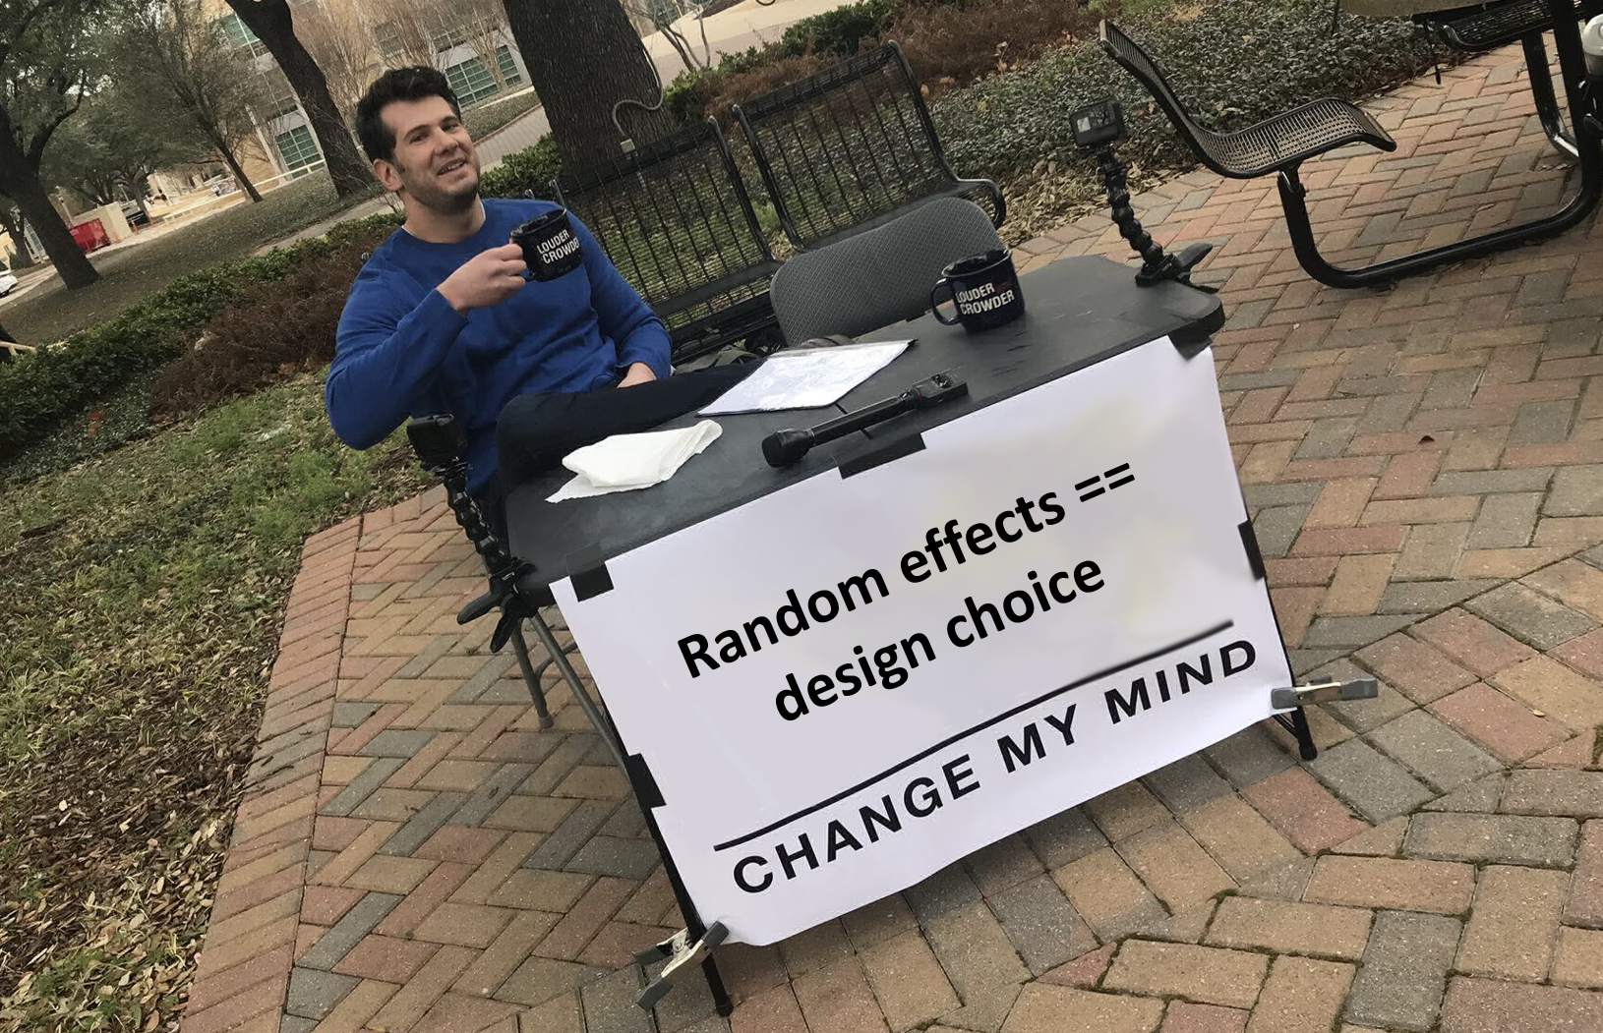

Slide 8
What can we learn from this?
Randomised design
Treatment factor
Control
Manipulation

Slide 9
What can we learn from this?
Paired design
Treatment factor
Control
Manipulation

Slide 10
What can we learn from this?
Blocked design
Treatment factor
Control
Manipulation

Slide 11
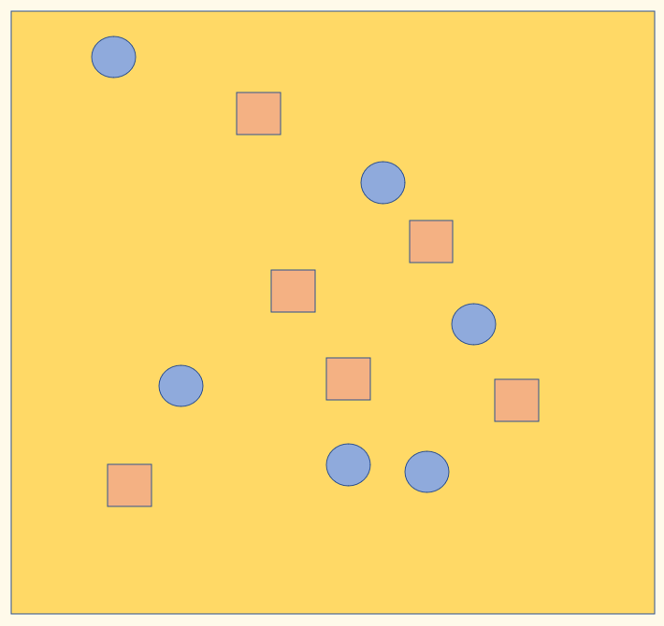
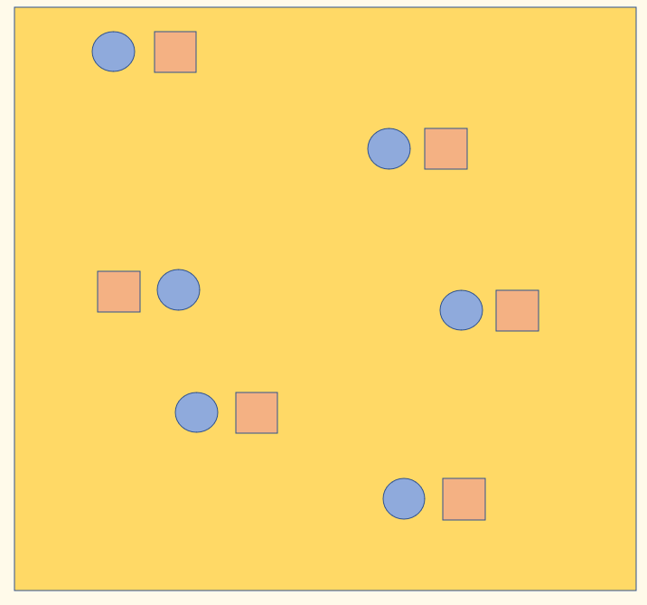
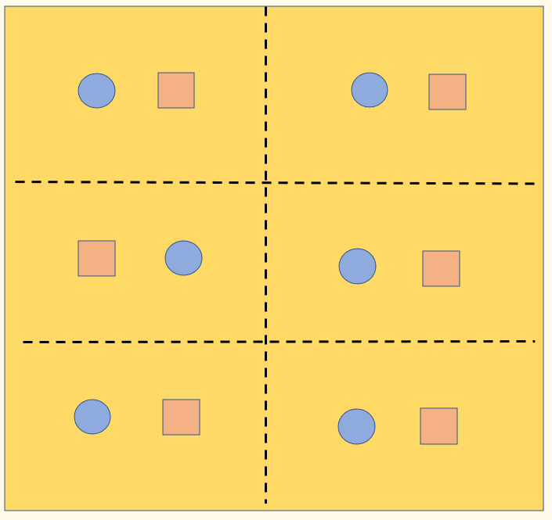
Randomised design
We learn different things from each of these designs
This is not a technical decision to make after data collection
Analysis is a fundamental intellectual issue to decide in the design of EVIDENCE creation
(i.e., prior to data collection)
Paired design
Blocked design

Slide 12
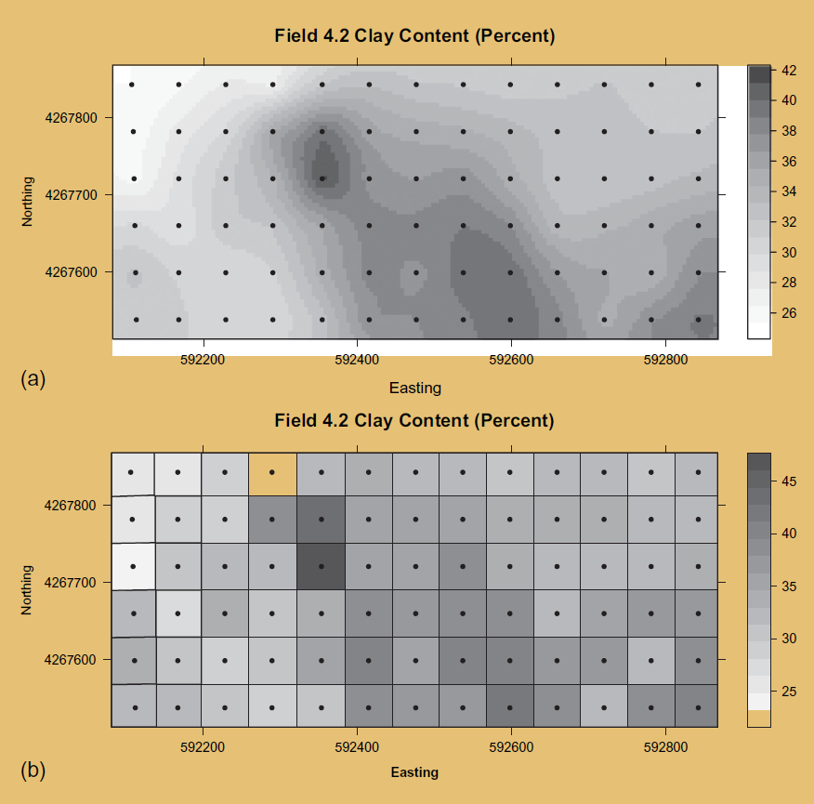
An example of spatial variation that can be controlled via mixed effects or blocking

Slide 13
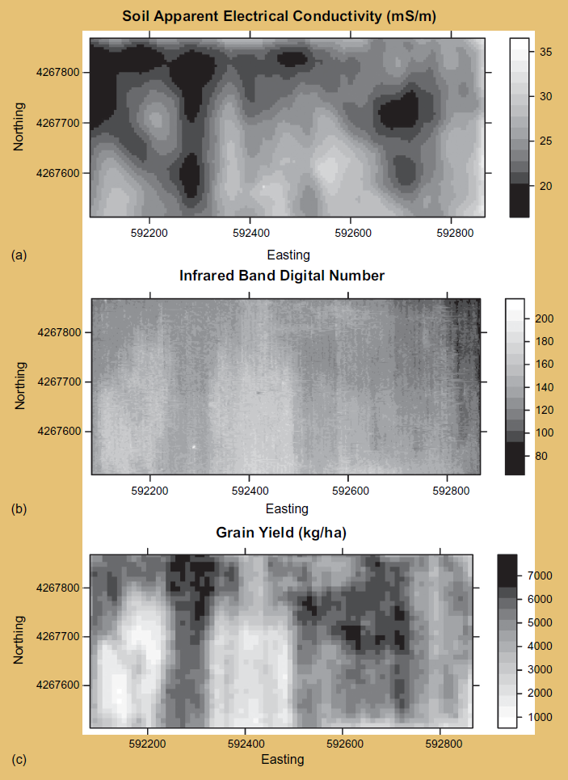
Another example of spatial variation that can be controlled via mixed effects or blocking

Slide 14
All fixed effects
Dependent
variable
Fixed variable

Slide 15
All fixed + random intercept
Block 1
Dependent
variable
Block 2
Fixed variable

Slide 16
All fixed + random intercept + random slope
Block 1
Dependent
variable
Block 2
Fixed variable

Slide 17
A few further remarks
Blocks are probably always best treated as RANDOM EFFECTS (e.g. we view blocks as spatial samples, representative of wider spatial variation)
Effective analysis of random effects has a burden of replication
By design, Blocks may be treated as fixed effects (e.g. there is a specific reason to be interested in the Blocks themselves)

Slide 18
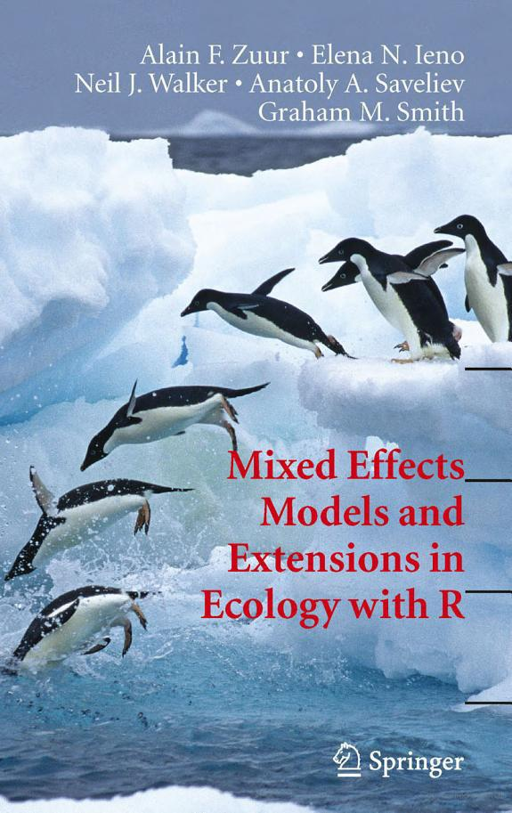
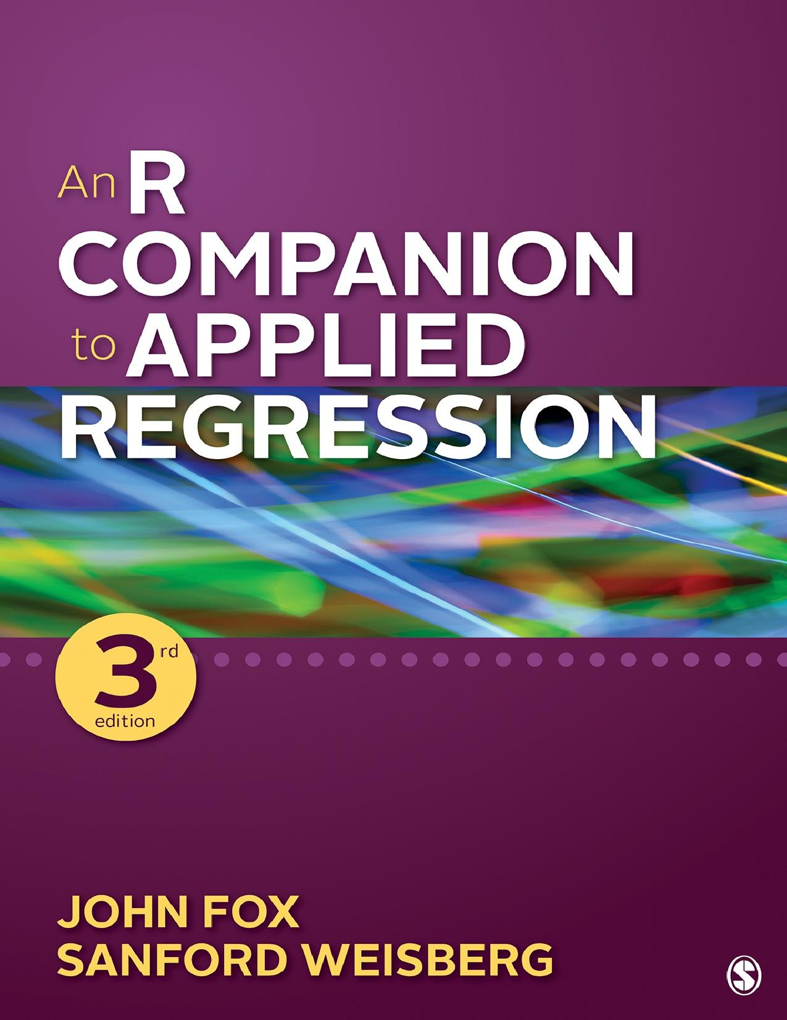
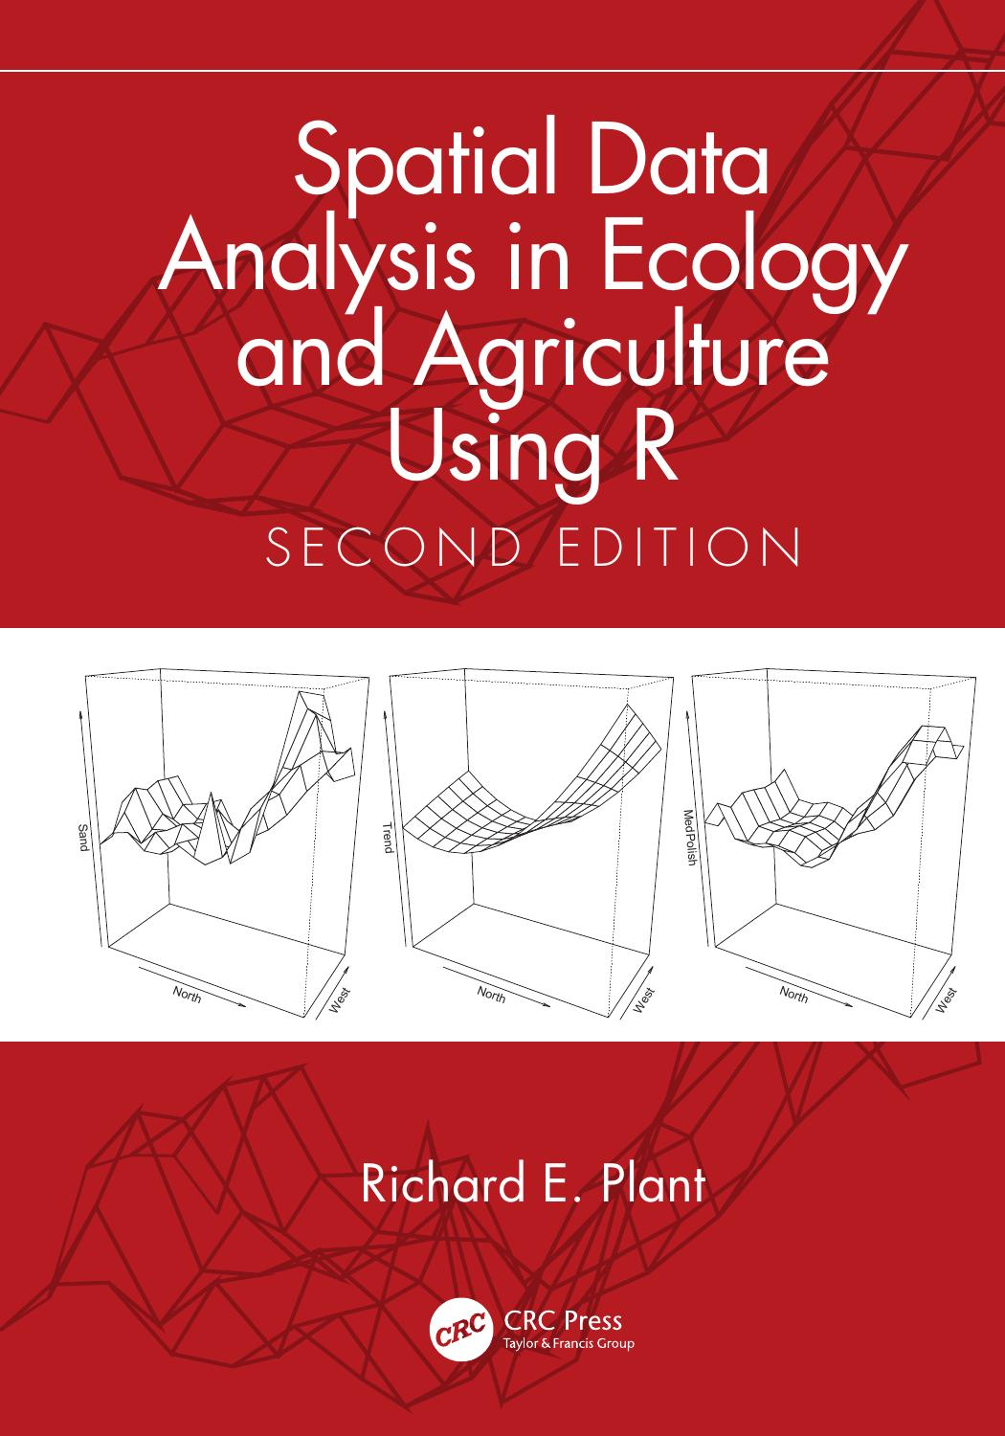
This stuff is hard
This requires both subject/information expertise and statistical expertise
Investment in skills building will pay career-long dividends

