Slide 1
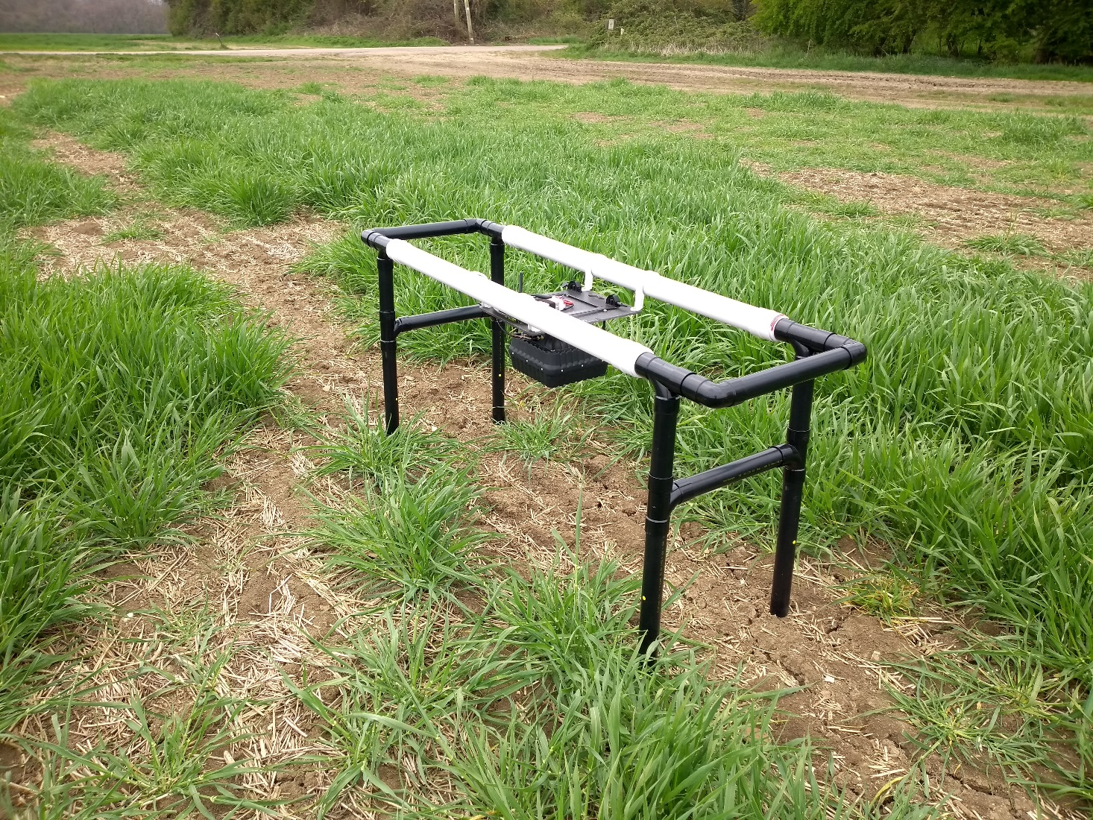
The classification of GPR signals using Keras
Przemek Dolowy
HARUG
April 2022

Slide 2
GROUND PENETRATING RADAR – WHY IT MIGHT DETECT SOIL COMPACTION
Presence of objects and voids
Crop growth
Layers of compacted soil
Vertical distribution of soil moisture
Water content
Relative dielectric permittivity (ε_{r}) of the scanned material
reflection wherever there is a change of ε_{r}
attenuation (frequency selective)
scattering on sub-wavelength structures
overlapping reflections create interference frequencies
Soluble salts
Mineralogical composition
Soil texture
Scanning height
Radar frequency
Radar specs

Slide 3
EARLIER RESULTS

Slide 4
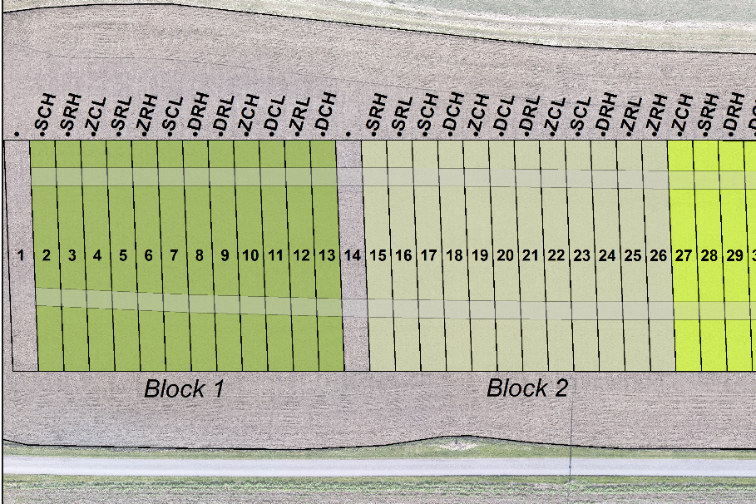
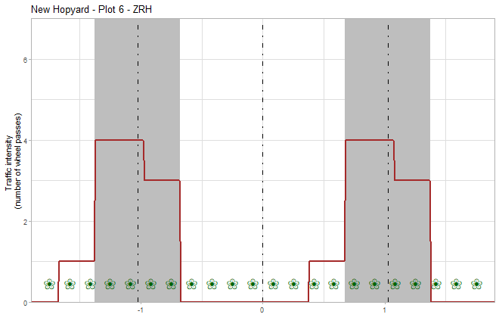
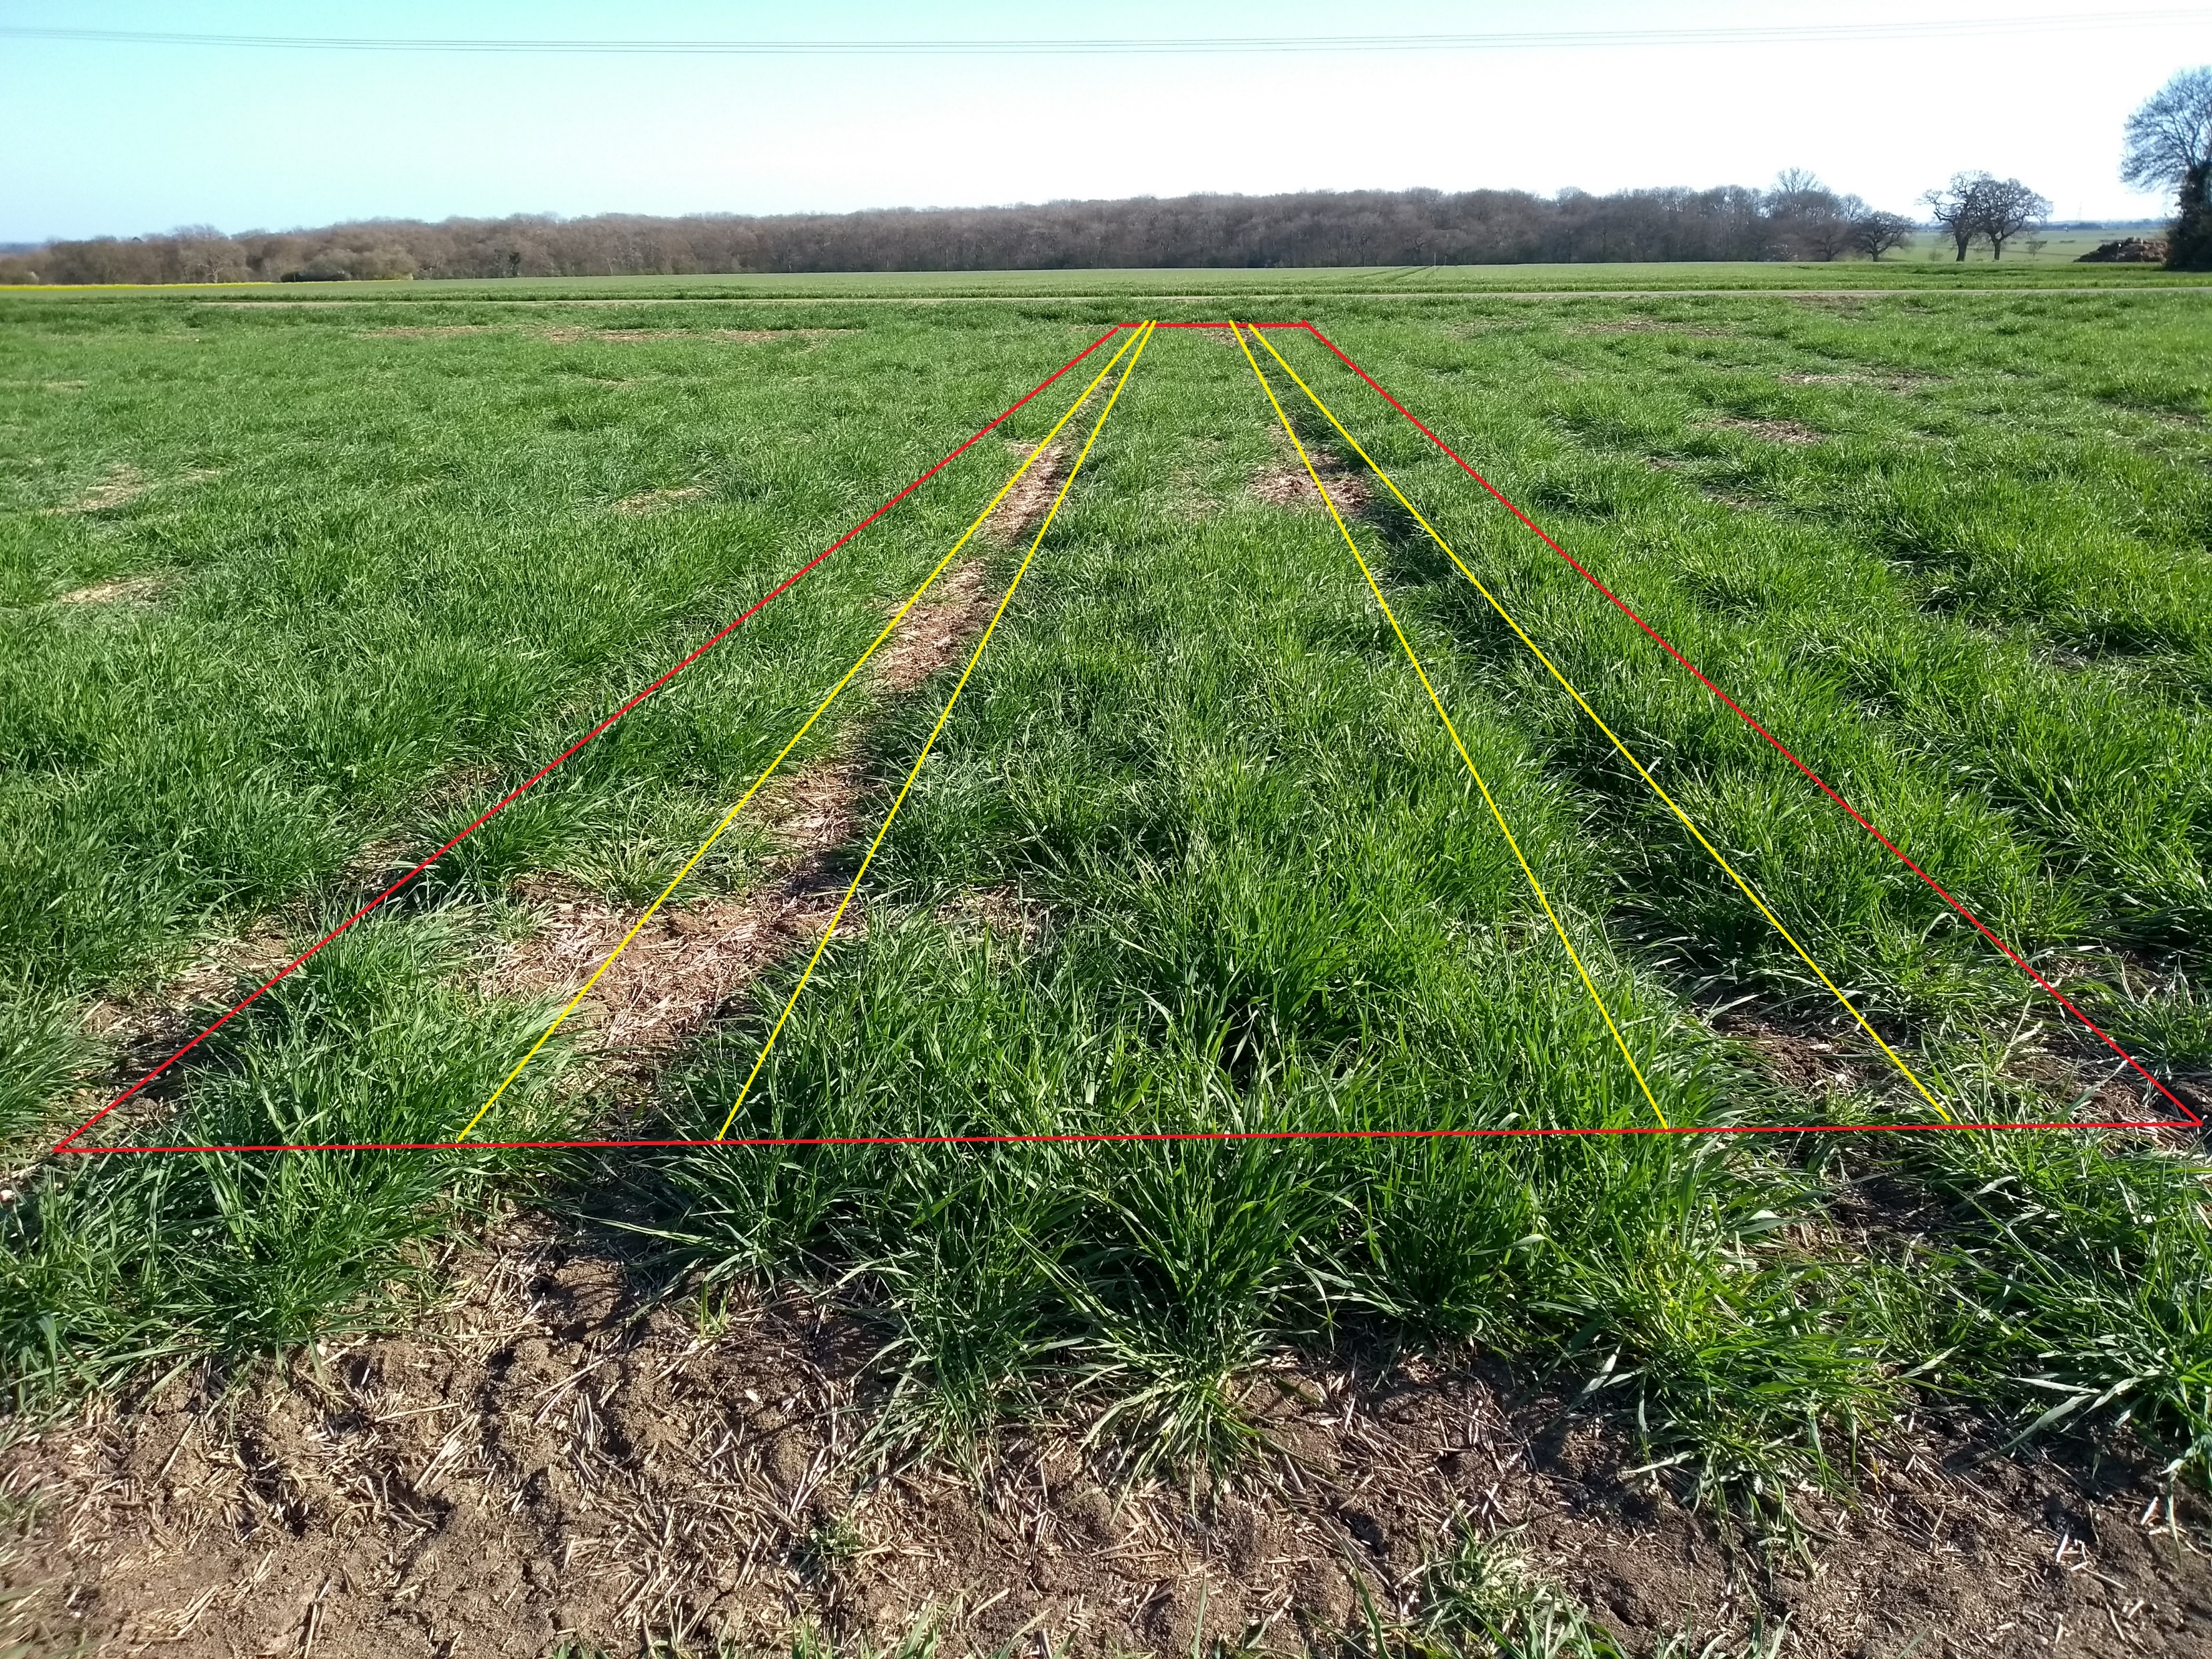
EXPERIMENTAL SITE STRUCTURE
plot width (ca 4 m)
W – wheelway
C – centre

Slide 5
GROUND PENETRATING RADAR (GPR)
STATIC SCANNING OF THE FIELD EXPERIMENTAL SITES
Number of scans in the datasets
Large Marsh 1 – 440
New Hopyard 1 – 480
Large Marsh 2 – 858
New Hopyard 2 – 930
Scanning the New Hopyard experimental site (April 2021)

Slide 6
LABELS TO PREDICT WITH KERAS
Label | Values | Comment
Zone | W – wheelway C – Centre | Crop rows 4-7 Crop rows 10-13
Traffic Contrast | HT – High Traffic LT – Low Traffic | 0-1 wheel passes annually 2-4 wheel passes annually
Tillage Depth | D – Deep S – Shallow Z – Zero | 250 mm 100 mm Zero tillage
Tyre Pressure | H – Standard (High) L – Low
Block | 1, 2, 3, 4
Moisture Contrast | HMC – High LMC – Low | Soil water content threshold depending on site

Slide 7
DATA ACQUISITION AND PRE-PROCESSING
Static GPR scan in a proprietary GSF format
Field notes from scanning
Data handling and pre-processing scripts
import: GSF >> SGY >> CSV
stacking
labelling (attaching information)
Site structure:
- experimental factors on plots,
- trafficking pattern
Soil moisture data
A time-domain dataset in CSV format, row-wise,
1 averaged trace per scan
data labels (site, date, plot number, position, treatments, and so on)

Slide 8
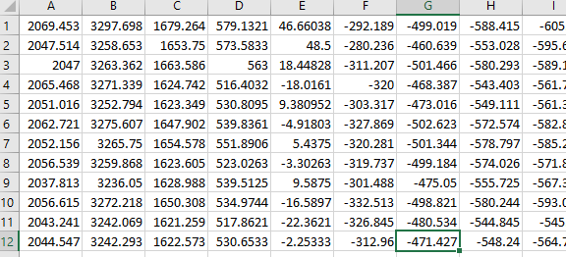
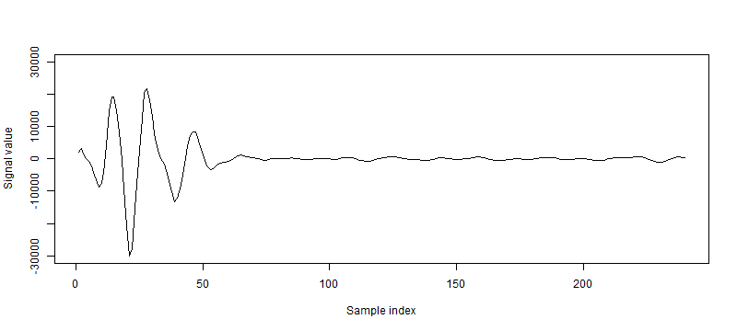
A TIME-DOMAIN DATASET STRUCTURE
256 samples / trace (32 ns x 8 samples/ns)
n averaged traces in a dataset
Decimal range:
from -32768 to 32767
an example of a trace

Slide 9
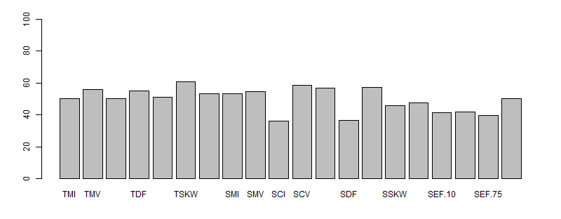
FEATURE VECTORS FOR CLASSIFICATION
3 options:
TD - a selected section of the time-domain signal
FT - a spectrum of a selected section of the time-domain signal
SA - a set of signal attributes calculated from the time-domain signal or/and the spectrum

Slide 10
HOW THE SIGNAL ATTRIBUTES ARE CALCULATED...
A selected setion of a time-domain trace
1) TD
Time-domain-based signal attributes (7)
Discrete Fourier Transform
3) SA
Signal attributes
2) FT
Amplitude spectrum
Amplitude spectrum-based signal attributes (9)
Squaring
Power spectrum
Power-spectrum-based signal attributes (4)

Slide 11
... AND NORMALISED
Signal attributes - raw
Z-normalisation: Z = (X – mean of X) / standard deviation of X
(in R: Z = scale(X) )
where X is the raw value of a given signal attribute
Signal attributes – Z-norm
Logistic transform: L = (100/(1+exp(-0.5*Z)))
Signal attributes – Logistic
Features for Keras

Slide 12
PROCESSING FLOW
passed to further stages
output to save
Settings (manual input)
ModelMasterLooped
make a settings list
ModelTrainAndTest
split CLASSES and FEATURES into training and test sets
define and compile the KERAS model
train and evaluate the model
generate predictions on test data
generate confusion matrix
save the trained model and settings
ModelData
read in and sub-select data
CLASSES vector
FEATURES matrix
Dataset
ModelStats
pre-eavaluation of features (optional)
pre-evaluated features
boxplots (optional)
corrplot
ModelReport
output a summary and barplots

Slide 13
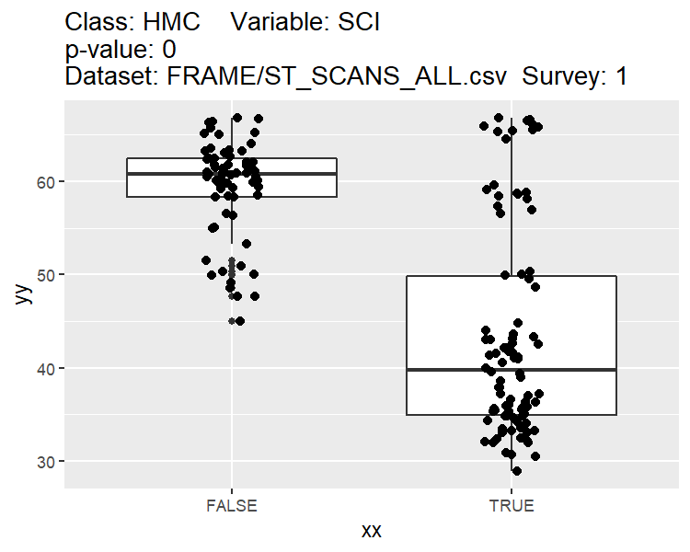
DISTRIBUTION OF THE FEATURES

Slide 14
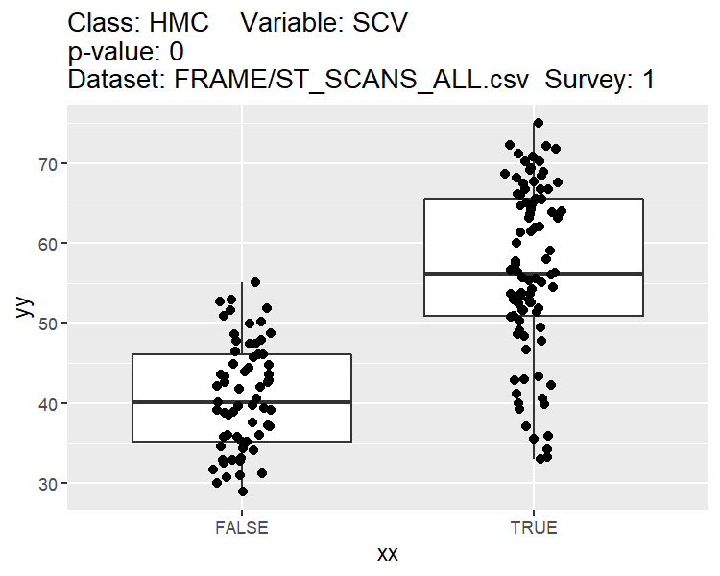
DISTRIBUTION OF THE FEATURES

Slide 15
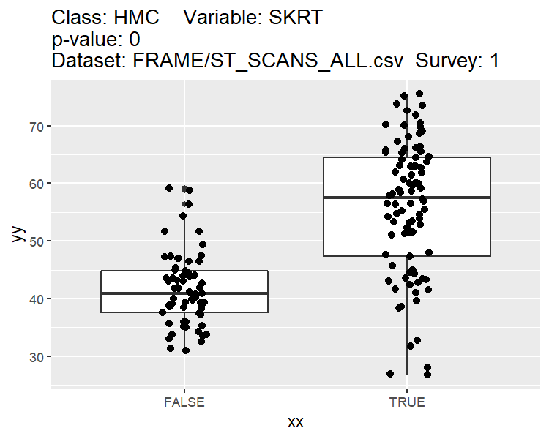
DISTRIBUTION OF THE FEATURES

Slide 16
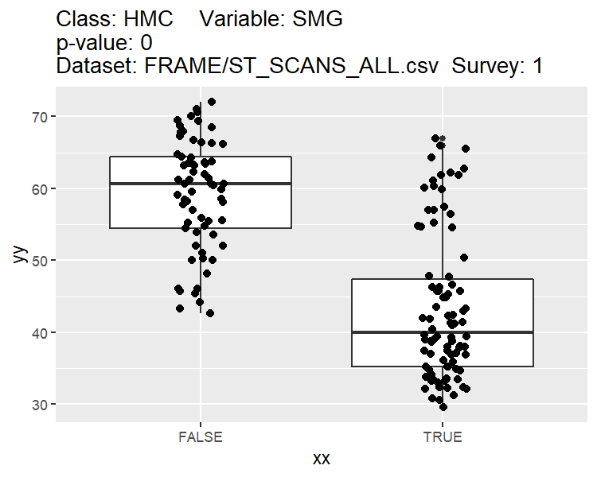
DISTRIBUTION OF THE FEATURES

Slide 17
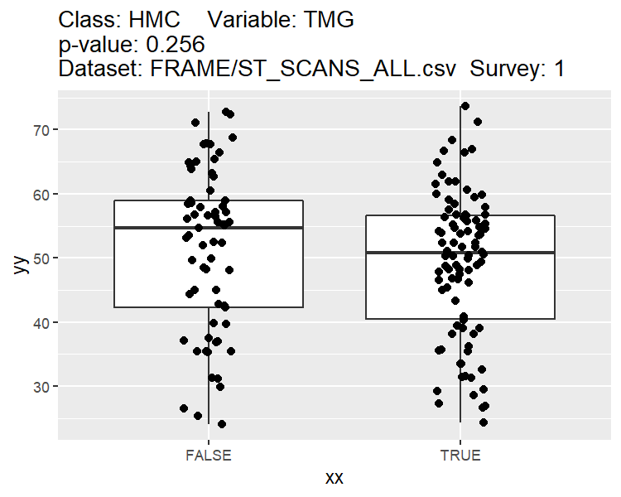
DISTRIBUTION OF THE FEATURES

Slide 18
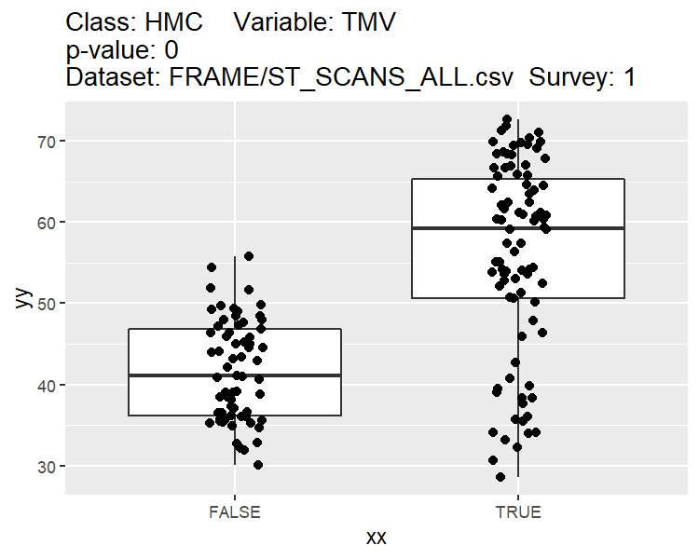
DISTRIBUTION OF THE FEATURES

Slide 19
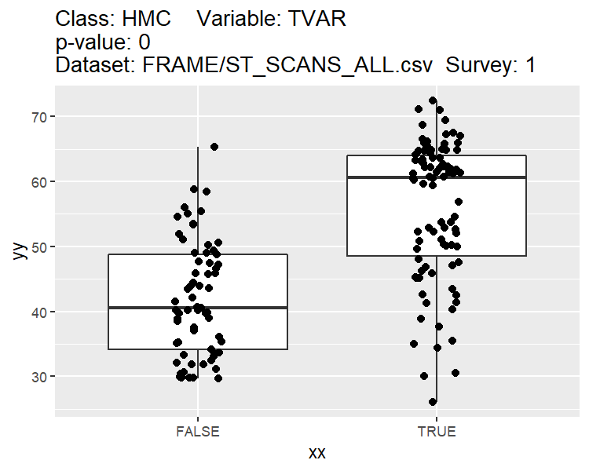
DISTRIBUTION OF THE FEATURES

Slide 20
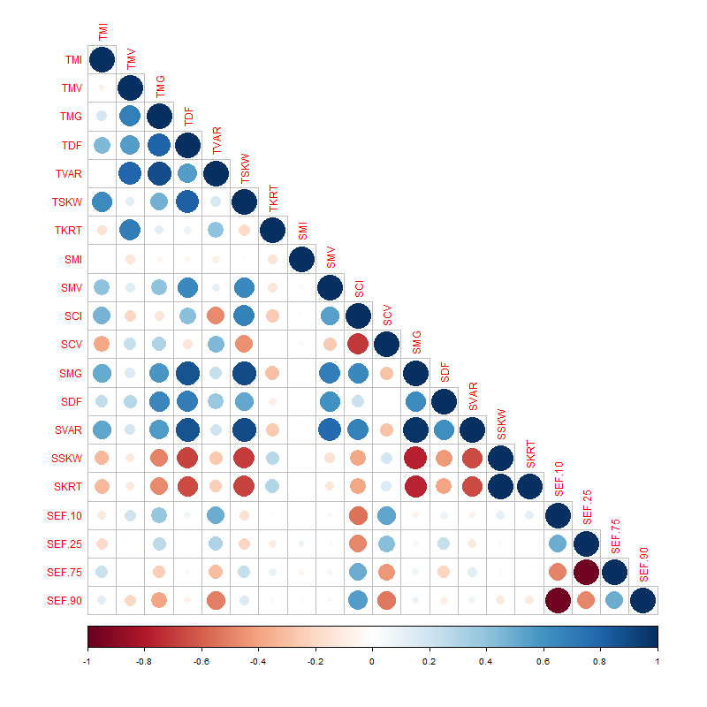
CORRELATION BETWEEN THE FEATURES

Slide 21
ASSESSMENT OF MODEL PERFORMANCE
Model performance was assessed using total accuracy.
A = correctly assigned labels / total number of classified examples
additionally:
- precision (by class)
P = correct predictions of class X to the overall number of predictions of class X
- recall (by class)
R = correct predictions of class X / all occurences of class X in the dataset

Slide 22
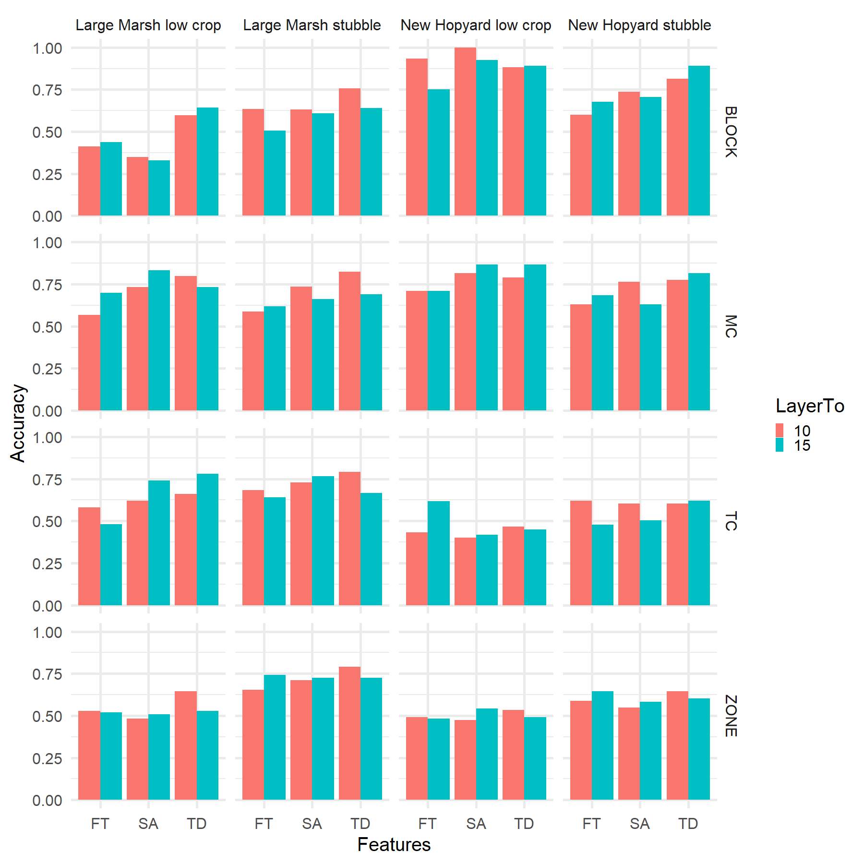
RUN 1

Slide 23
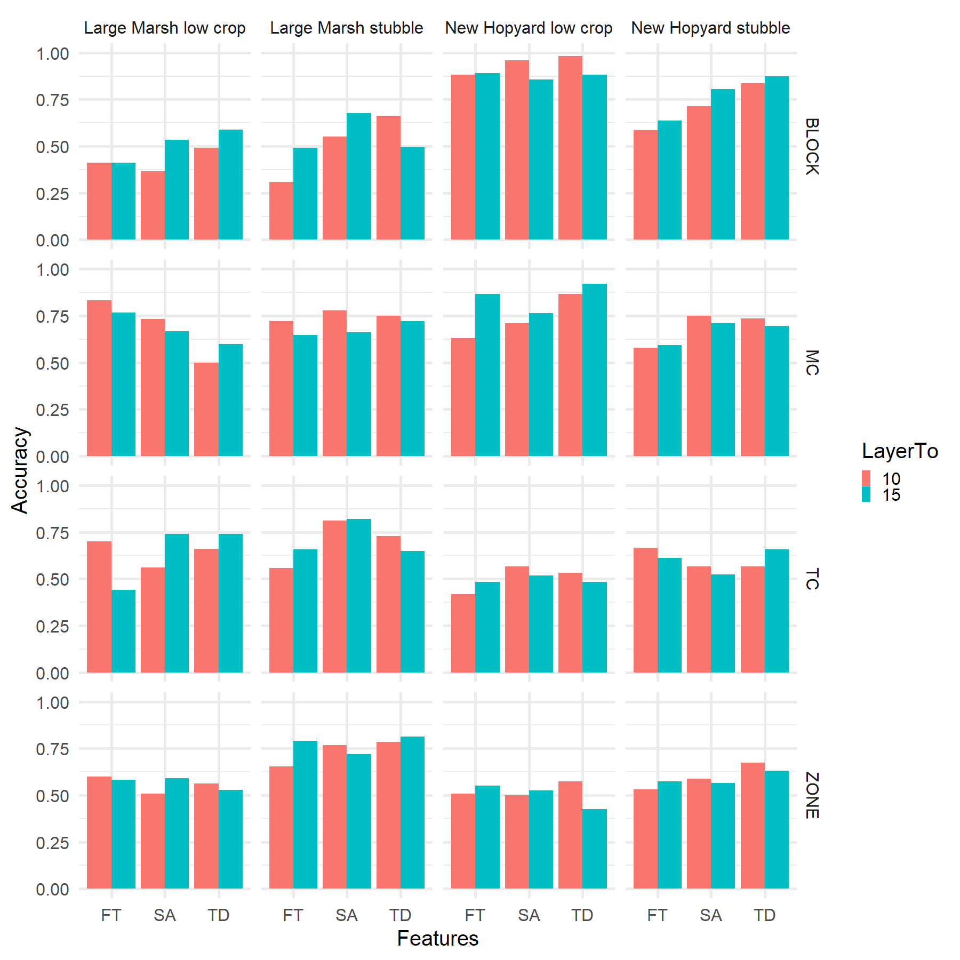
RUN 2

Slide 24
CONCLUSIONS
Detection of soil characteristics with GPR is possible
Soil moisture is likely to be the main factor…
…and a proxy to detect agricultural traffic
HOW TO MAKE IT WORK BETTER
Tweaks to the Keras model structure
Pre-processing, filtering…
Depth selection
Tweaks to the selection of attributes
New attributes?
More data!
Quick data collection in mobile mode with sufficient positioning precision

Slide 25
Thank you!

